Slide 1
Simulation Modeling
Definition of Simulation Modeling
Simulation Process
Monte Carlo Simulation
Advantages/Limitations of Simulation
Common Types of Input Distributions
Summary

Slide 2
Definition of Simulation
Simulation Definition:
Descriptive technique that enables a decision maker to evaluate the behavior of a model under various conditions, specifically when input variables change – i.e., a stochastic model
Simulation models complex situations
Models are simple to use and understand
Models can play “what if” experiments
Extensive software packages available

Slide 3
Simulation Process
1. Identify the problem
2. Develop the simulation model – chose input variable & output variables
3. Test the model
4. Develop the experiments
5. Run the simulation and evaluate results
6. Repeat 4 and 5 until results are satisfactory

Slide 4
Monte Carlo Simulation
• Probabilistic simulation technique used when a process has a random/stochastic component
Identify a probability distribution
Setup intervals of random numbers to match probability distribution
Obtain or sample the random numbers
(i.e., Monte Carlo simulation is random)
Collect & interpret the results

Slide 5
Advantages of Simulation
Solves problems that are difficult or impossible to solve mathematically
Allows experimentation without risk to actual system
Compresses time to show long-term effects
Serves as training tool for decision makers
Randomization makes each simulation run different from the previous run

Slide 6
Limitations of Simulation
Does not produce optimum solution
Model development may be difficult
Monte Carlo simulation only applicable to random systems
Outputs can be difficult/complex to explain to client
Large # of runs produce more accurate results (e.g., small # of runs are less accurate)

Slide 7
Common Types of Input Distributions
Numerous probability distributions can be used as inputs
Common distributions
Uniform
Normal
Triangular
Each distribution has specific characteristics

Slide 8
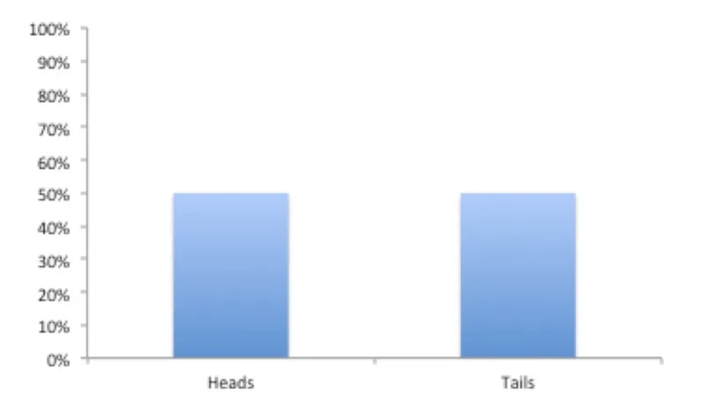
Uniform Distribution
Characteristics
Equally likely outcomes
In discrete form, outcomes are discrete and have the same probability (coin flip)
In continuous form, outcomes
are continuous and infinite
e.g., coin flip
(50% heads/50% tails)
P(x) =Probability
x = Outcome

Slide 9
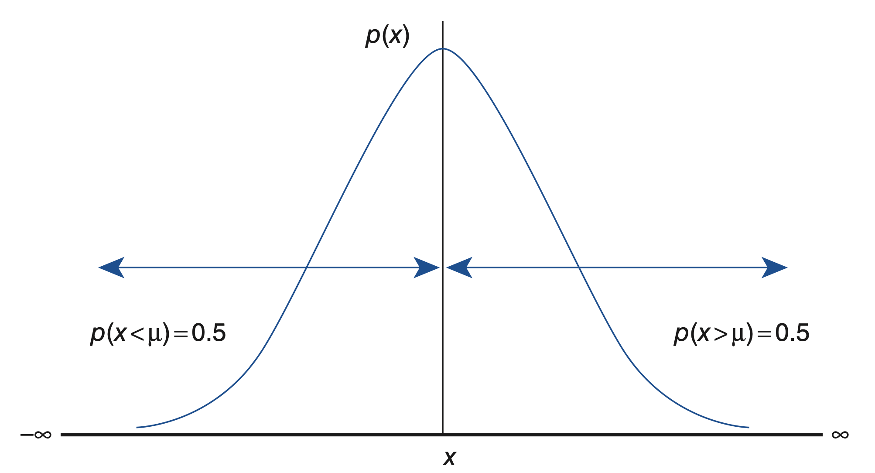
Normal Distribution
Characteristics
Gaussian distribution or bell curve
Symmetrical & bell-shaped
Parameters are mean (average) &
standard deviation/SD (dispersion of the
data)
Most data points cluster around the
mean, with fewer data points appearing
further away from the mean
Mean, median, & mode are all equal

Slide 10
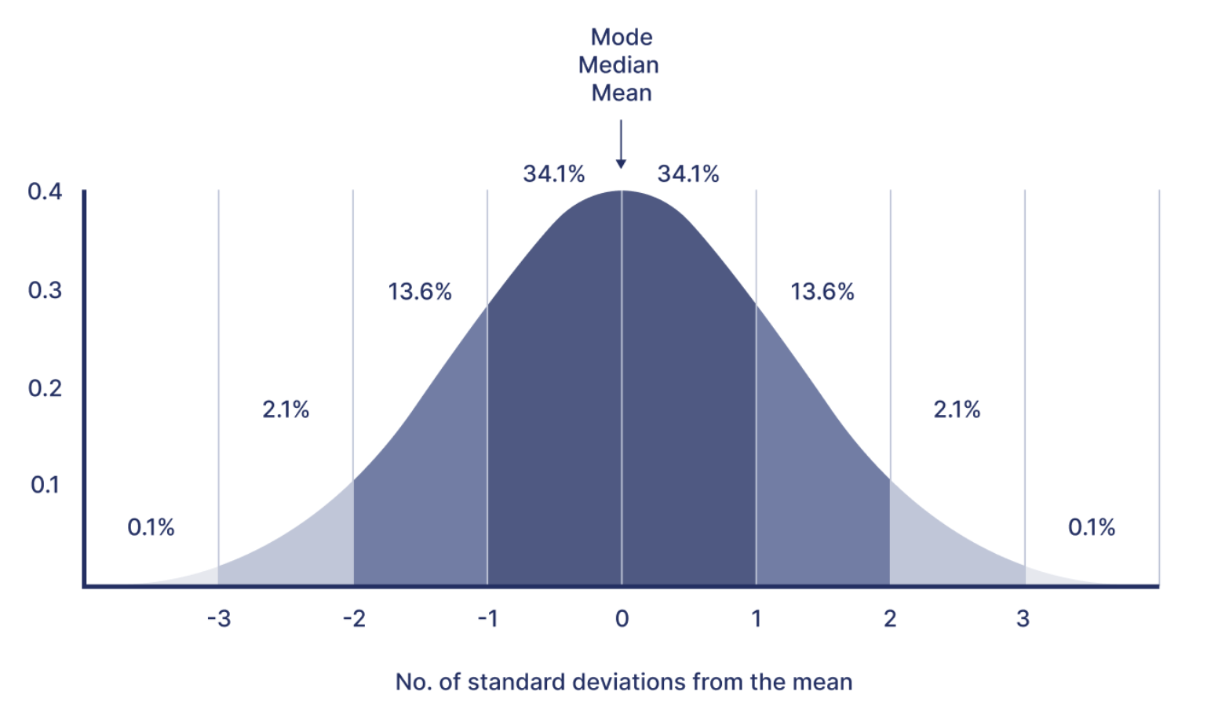
Normal Distribution
Rules of Thumb
~ 68% of values lie
+/- 1 SD from mean
~ 95.5% of values lie
+/- 2 SD from mean
~ 99.7% of values lie
+/- 3SD from mean
Note: ~ denotes approximate
Mean
Median
Mode
P(x) =Probability
x = # of SD from Mean

Slide 11
Normal Distribution
Example
Given: mean (average) = 10 & standard deviation/SD = 3
Approximately 68% of the values lie between:
10 – 1*3 to 10+1*3 or 7 to 13
Approximately 95.5% of the values lie between:
10 – 2*3 to 10+2*3 or 4 to 16
Approximately 99.7% of the values lie between:
10 – 3*3 to 10+3*3 or 1 to 19

Slide 12
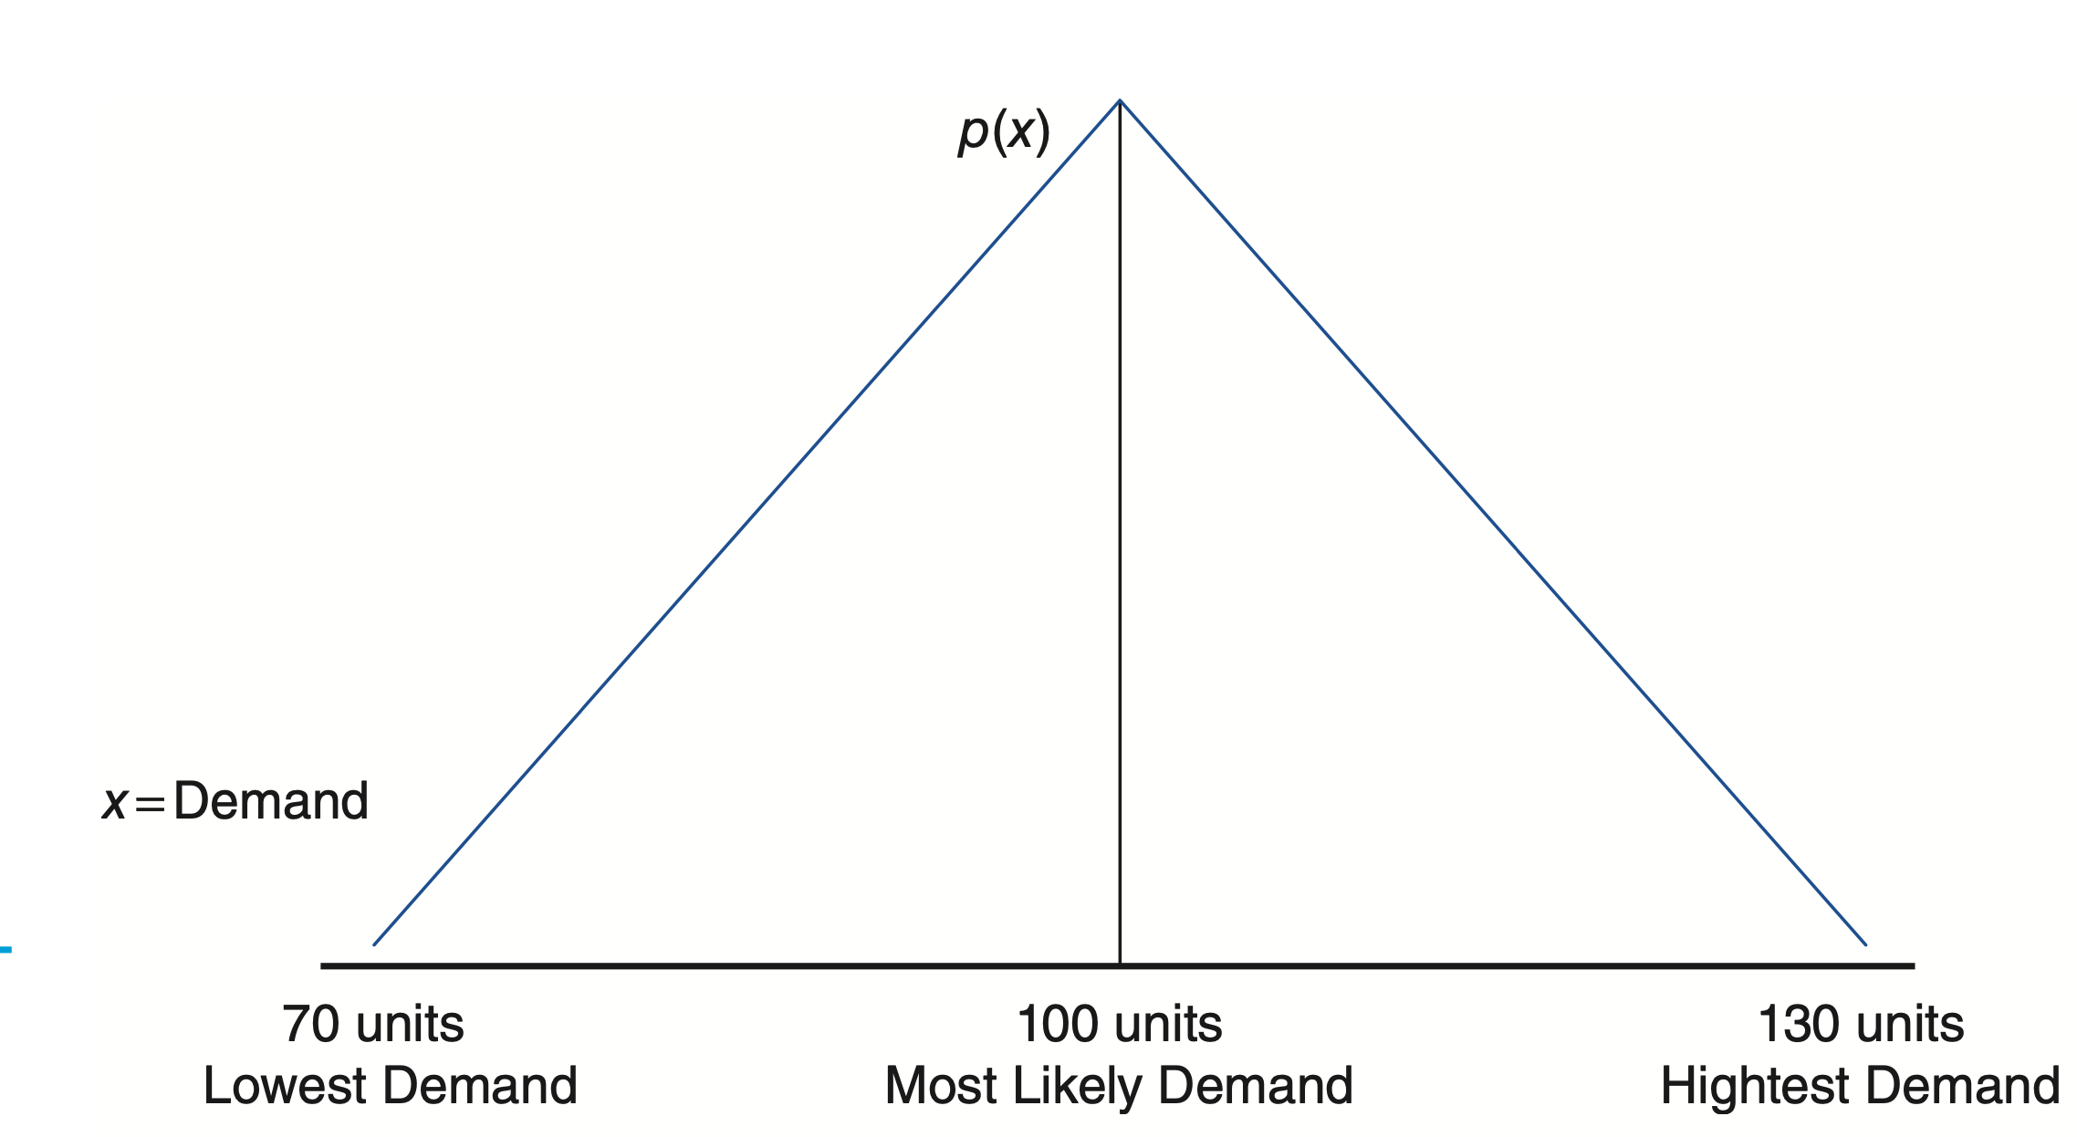
Triangular Distribution
Triangular
Alternative to Normal
Used for many business
applications
It can be symmetrical
or not
Has definitive end points
(high/low limits)
P(x)
X
Low/Min Most Likely High/Max

Slide 13
Triangular Distribution
Triangular vs. Normal
Two areas of concern w/Normal
Lack of Symmetry in real data
Sampling outside given limits (definitive low or high points)
Rarely in business is data symmetric above & below the mean (think salaries in big companies)
Business applications tend to have definitively lower points (e.g., negative ticket sales do not make sense)
Business applications tend to have definitively high points (e.g., if the stadium holds 50,000 at max that is what it can hold)

Slide 14
Summary
Simulation is a technique that enables a decision maker to evaluate the behavior of a model under various conditions, specifically when input variables change – i.e., a stochastic model
Monte Carlo simulation is a technique where your build a model of a process & use random inputs to conduct “what if” analysis
Advantages include solving problems that are difficult or impossible to solve mathematically & outputs that can be used for sensitivity analysis
Limitations: does not return an optimal solution, model development is complex, only random systems can be simulated, large # of runs needed
Distributions are used for model inputs
Common distributions: Uniform, Normal, & Triangular

