Slide 1
Hypothesis Testing & Standard Deviation
Measures dispersion of data set & is in same units as the measure of central tendency
Describes shape of data set & underlying distribution
Underlying distribution?!? What?!?
Common underlying distributions:
  Normal, Exponential, Poisson, Lognormal….

Slide 2
Normal Distribution
Common probability distribution
e.g., height, weight, age, sum of two dice rolled 1,000 times, etc.

Slide 3
Normal Distribution

Slide 4
Comparing Two Distributions?
What if we have two distributions? Two means?
Can we claim that one distribution is different than the other? What about the means? i.e.,
    The means are from the same sample population
  or
    The means are from different sample populations

Slide 5
What does this look like?

Slide 6
Why Hypothesis Test?
Validate a claim e.g.,
  Is a coin fair?
Discriminate between a sample & a population,
  Are females salaries on average the same as whole company?
Statistically prove a similarity or difference,
  Does blood pressure medicine significantly reduce blood pressure?
Solve problems in business, science, law, healthcare, government, etc.

Slide 7
Hypothesis Testing (Two-Tailed)
Standard Test for Comparing Data Sets
Composed of 4 Parts
  Null Hypothesis: Ho
  Alternative Hypothesis: Ha
  Test Statistic: z-stat vs z-crit
  Rejection Region: follow rules of thumb
Testing if mean₁ = μ (population mean) (2 tailed)
(Note: We assume sample size is large, n > 30)

Slide 8
Null Hypothesis
What is the Null Hypothesis, Ho?
  Ho is the claim that you are trying to prove….e.g.,
  Ho: The sample is from the population
  or
  Ho: sample mean₁ = population mean
  or
  Ho: female salaries of XYZ = population salaries

Slide 9
Alternative Hypothesis?
What is the Alternative Hypothesis, Ha?
  Ha is the converse of Ho….e.g.,
  Ha: The sample mean is not from population
  or
  Ha: sample mean₁ ≠ population mean
  or
  Ha: female salaries ≠ population salaries

Slide 10
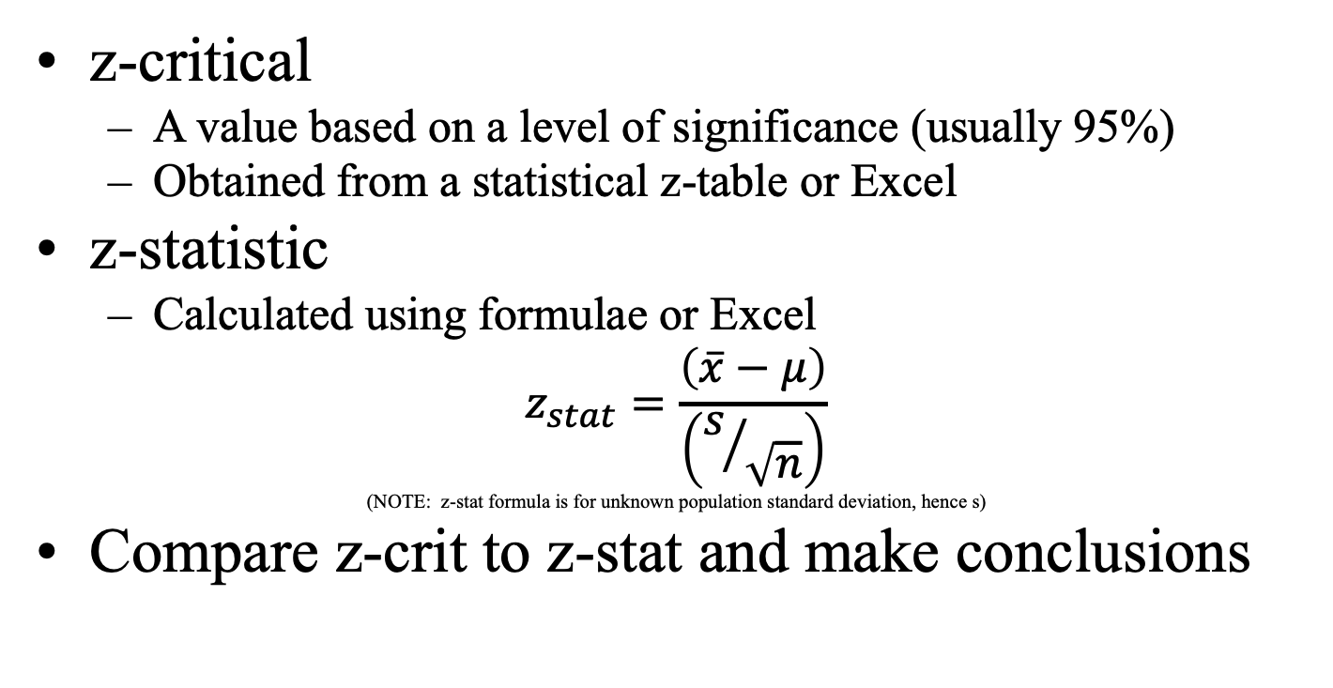
Test Statistics
z-critical
  A value based on a level of significance (usually 95%)
  Obtained from a statistical z-table or Excel
z-statistic
  Calculated using formulae or Excel
$$z_{stat}=\frac{\left(\overline{x}−μ\right)}{\left(s/{\sqrt{n}}\right)}$$
(NOTE: z-stat formula is for unknown population standard deviation, hence s)
Compare z-crit to z-stat and make conclusions

Slide 11
Comparison of z-stat and z-crit
Rules of Thumb
  Calc z-stat
  Obtain z-crit
  If: |z-stat| > |z-crit|, Reject the Null Ho
  If: |z-stat| < |z-crit|, Fail to Reject* the Null Ho
  (*NOTE: Standard statistical nomenclature, instead of saying we accept the Null)

Slide 12
Hypothesis Testing (two tailed)
Rules of Thumb:
Calc z-stat, look up z-crit,
&
If |z-stat| > z-crit, Reject Ho
If |z-stat| < z-crit, Fail to Reject Ho

Slide 13
Hypothesis Testing (two tailed) – Example for 10% Significance
Rules of Thumb:
Calc z-stat, look up z-crit,
&
If |z-stat| > z-crit, Reject Ho
If |z-stat| < z-crit, Fail to Reject Ho
Z-crit = -1.645
Z-crit = +1.645

Slide 14
Finding z_{crit}
based on a level of significance (e.g., 0.10, 0.05, 0.01)
z_{crit} value can be obtained from a statistical z-table
Zcrit for Commom Values of α, n > 30
α | |z-crit| | If |z-stat| > |z-crit|, then
0.10 | 1.645 | Reject Ho if |z-stat| > 1.645
0.05 | 1.96 | Reject Ho if |z-stat| > 1.96
0.01 | 2.575 | Reject Ho if |z-stat| > 2.575

Slide 15
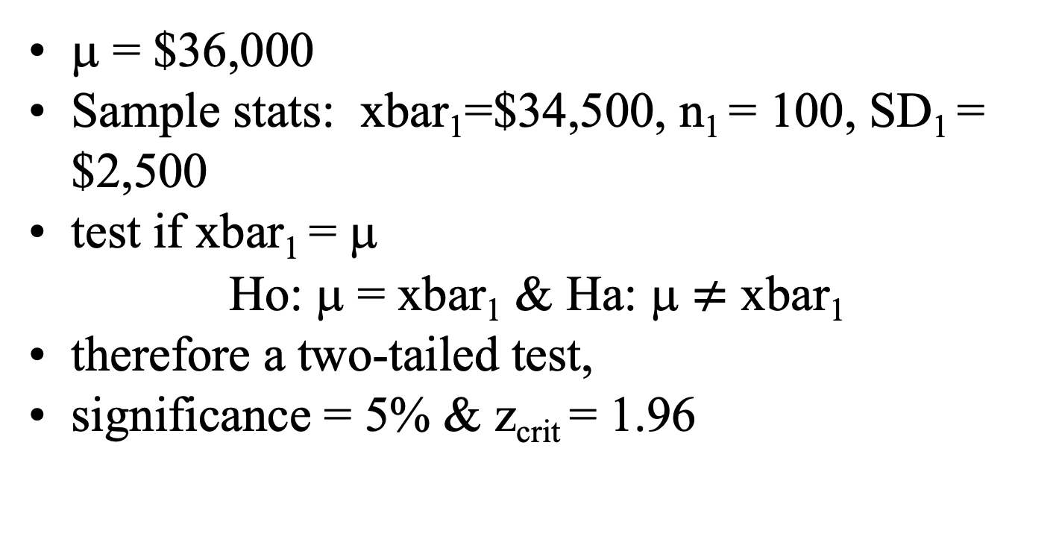
Example – Salary Comparison
μ = $36,000
Sample stats: xbar₁=$34,500, n₁ = 100, SD₁ = $2,500
test if xbar₁ = μ
Ho: μ = xbar₁ & Ha: μ $≠$ xbar₁
therefore a two-tailed test,
significance = 5% & z_{crit} = 1.96

Slide 16

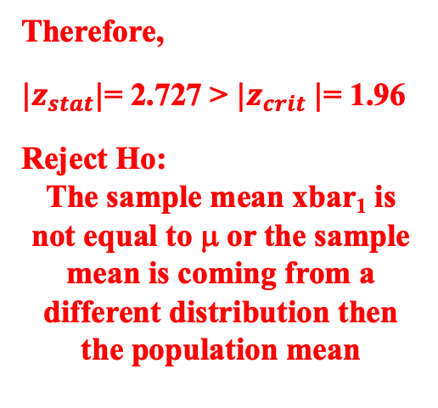
Example – Salary Comparison
Given: μ = $36,000, xbar₁=$34,500, n₁ = 100, SD₁ = $5,500, & z_{crit} = 1.96
$z_{stat}=\frac{\left(\$34,500−\$36,000\right)}{\left({\$5,500}/{\sqrt{100}}\right)}$= -2.727
      $z_{stat}$= -2.727 $z_{crit}$= +/-1.96
Rules of Thumb:
Calc z-stat, look up z-crit, &
If |z-stat| > z-crit, Reject Ho
If |z-stat| < z-crit, Fail to Reject Ho
Therefore,
${|z}_{stat}|$= 2.727 > $|z_{crit} |$= 1.96
Reject Ho:
The sample mean xbar₁ is not equal to μ or the sample mean is coming from a different distribution then the population mean
x

