Slide 1
Types of Statistical Applications
Hypothesis Testing Concepts
Notes:
5

Slide 2
Hypothesis Testing
Population
I believe the population mean age is 50 (hypothesis).
Random
sample
☺
☺
☺
☺
☺
Accept/Reject
hypothesis! Close or Not close?
☺
Mean
Xbar=20
☺
☺
☺

Slide 3
What’s a Hypothesis?
• Belief about a population parameter
  Making an inference about how the value of a parameter relates to a specific value
    e.g., is the sample mean equal to the population mean
  Must be stated before analysis

Slide 4
Null Hypothesis
1. What is tested
2. Has serious outcome if incorrect decision made
3. Always has equality sign: =, ≤, or ≥
4. Designated H₀ (pronounced H-oh)
5. Specified as H₀: μ = Some numeric value
  Written with = sign even if ≤, or ≥
  Example, H₀: μ = 3

Slide 5
Alternative Hypothesis
1. Opposite of null hypothesis
2. Always has inequality sign: ≠, <, or >
3. Designated H_{a}
4. Specified H_{a}: μ < Some value
  Example, H_{a}: μ < 3

Slide 6
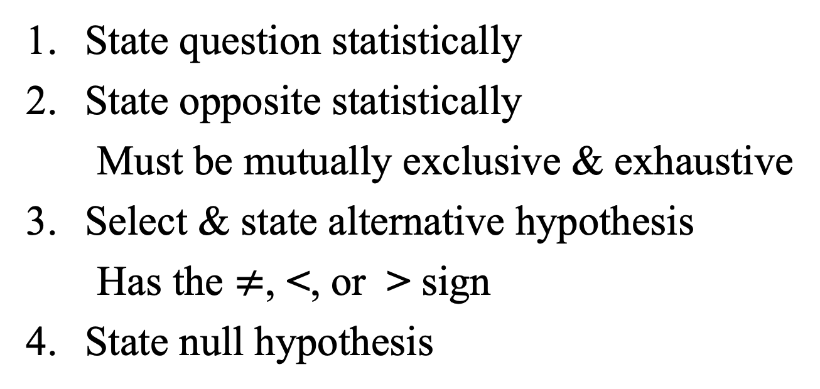
Identifying Hypotheses Steps
1. State question statistically
2. State opposite statistically
  Must be mutually exclusive & exhaustive
3. Select & state alternative hypothesis
  Has the $≠$, <, or > sign
4. State null hypothesis

Slide 7
Identifying Hypotheses
Example 1
Is the population mean different from 3?

Slide 8
Identifying Hypotheses
Example 1 Answer
Is the population mean the same as 3?
1. μ = 3
2. μ ≠ 3
3. H₀: μ = 3
4. H_{a}: μ ≠ 3

Slide 9
Identifying Hypotheses
Example 2
Is the population average amount of TV viewing 12 hours?

Slide 10
Identifying Hypotheses
Example 2 Answer
Is the population average amount of TV
viewing 12 hours?
1. μ = 12
2. μ ≠ 12
3. H₀: μ = 12
4. H_{a}: μ ≠ 12

Slide 11
Identifying Hypotheses
Example 3
Is the average cost per hat less than or equal to $20?

Slide 12
Identifying Hypotheses
Example 3 Answer
Is the average cost per hat less than or equal to $20?
1. μ ≤ 20
2. μ > 20
3. H_{a}: μ > 20
4. H₀: μ = 20

Slide 13
Identifying Hypotheses
Example 4
Is the average amount spent in the bookstore greater than $25?

Slide 14
Identifying Hypotheses
Example 4 Answer
Is the average amount spent in the bookstore greater than $25?
1. μ > 25
2. μ ≤ 25
3. H_{a}: μ > 25
4. H₀: μ = 25

Slide 15
Basic Idea
P(X)
Sampling Distribution
X
μ
S
a
m
p
l
e
M
e
a
n

Slide 16
Rejection Region (One-Tail Test)
Sampling Distribution
P(X)
Rejection Region
X
Ho Value
Sample Statistic
Notes:
Rejection region does NOT include critical value.

Slide 17
Basic Idea
Sampling Distribution
It is unlikely that we would get a sample mean of this value ...
... therefore, we reject the hypothesis that μ = 50.
... if in fact this were
the population mean
P(X)
μ = 50 H₀
X
20
Sample Mean

Slide 18
Level of Significance
1. Defines unlikely values of sample statistic if null hypothesis is true
  Called rejection region of sampling distribution
2. Is a probability
3. Denoted α (alpha)
4. Selected by researcher at start
  Typical values are 0.01, 0.05, 0.10

Slide 19
Rejection Region (One-Tail Test)
Sampling Distribution
Level of Confidence
R
e
j
e
c
t
i
o
n
P(X)
R
e
g
i
o
n
α
1 - α
N
o
n
r
e
j
e
c
t
i
o
n
R
e
gi
o
n
X
H
o
S
a
m
p
l
e
S
t
a
t
i
s
t
i
c
C
r
i
t
i
c
a
l
V
a
l
u
e
V
a
l
u
e
Notes:
Rejection region does NOT include critical value.

Slide 20
Rejection Region (One-Tail Test)
Sampling Distribution
Level of Confidence
P(X)
R
e
j
e
c
t
i
o
n
R
e
g
i
o
n
α
1 - α
N
o
n
r
e
j
e
c
t
i
o
n
R
e
g
i
o
n
X
H
o
S
a
m
p
l
e
S
t
a
t
i
s
t
i
c
C
r
i
t
i
c
a
l
V
a
l
u
e
V
a
l
u
e
Observed sample statistic
Notes:
Rejection region does NOT include critical value.

Slide 21
Rejection Region (One-Tail Test)
Sampling Distribution
Level of Confidence
R
e
j
e
c
t
i
o
n
P(X)
R
e
g
i
o
n
1 - α
α
N
o
n
r
e
j
e
c
t
i
o
n
R
e
g
i
o
n
X
Observed sample statistic
H
o
S
a
m
p
l
e
S
t
a
t
i
s
t
i
c
C
r
i
t
i
c
a
l
V
a
l
u
e
V
a
l
u
e
Notes:
Rejection region does NOT include critical value.

