Slide 1
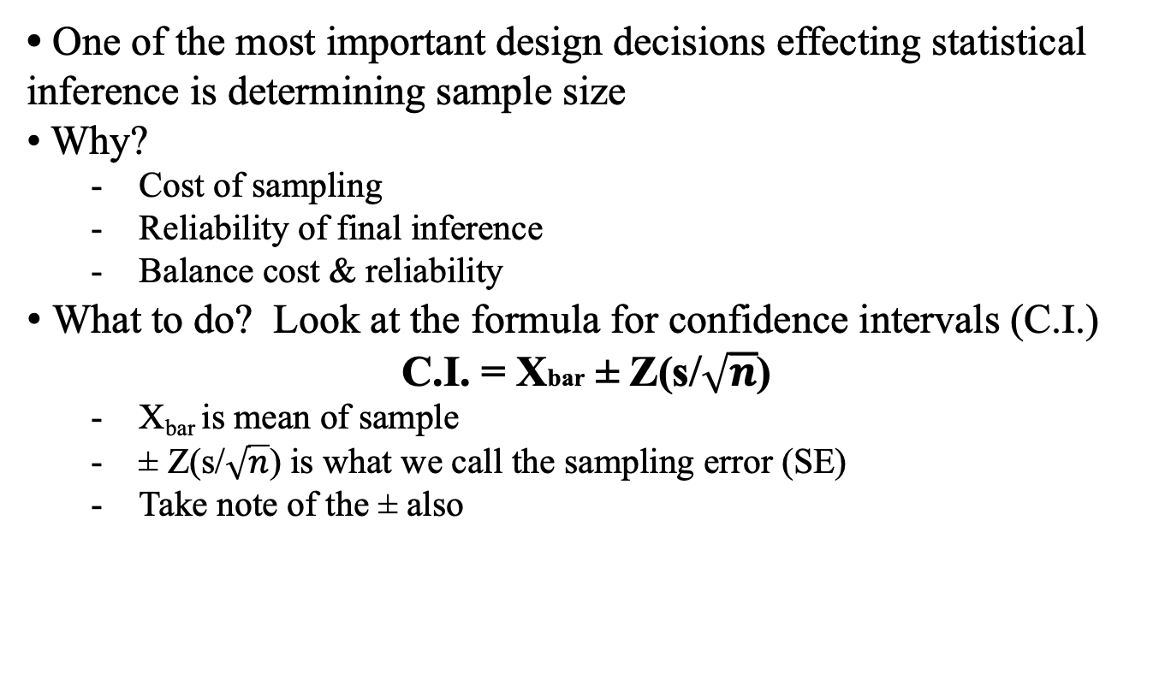
Determining Sample Size - n
• One of the most important design decisions effecting statistical inference is determining sample size
• Why?
  Cost of sampling
  Reliability of final inference
  Balance cost & reliability
• What to do? Look at the formula for confidence intervals (C.I.)
C.I. = Xbar ± Z(s/$\sqrt{n}$)
  X_{bar} is mean of sample
  ± Z(s/$\sqrt{n}$) is what we call the sampling error (SE)
  Take note of the ± also

Slide 2
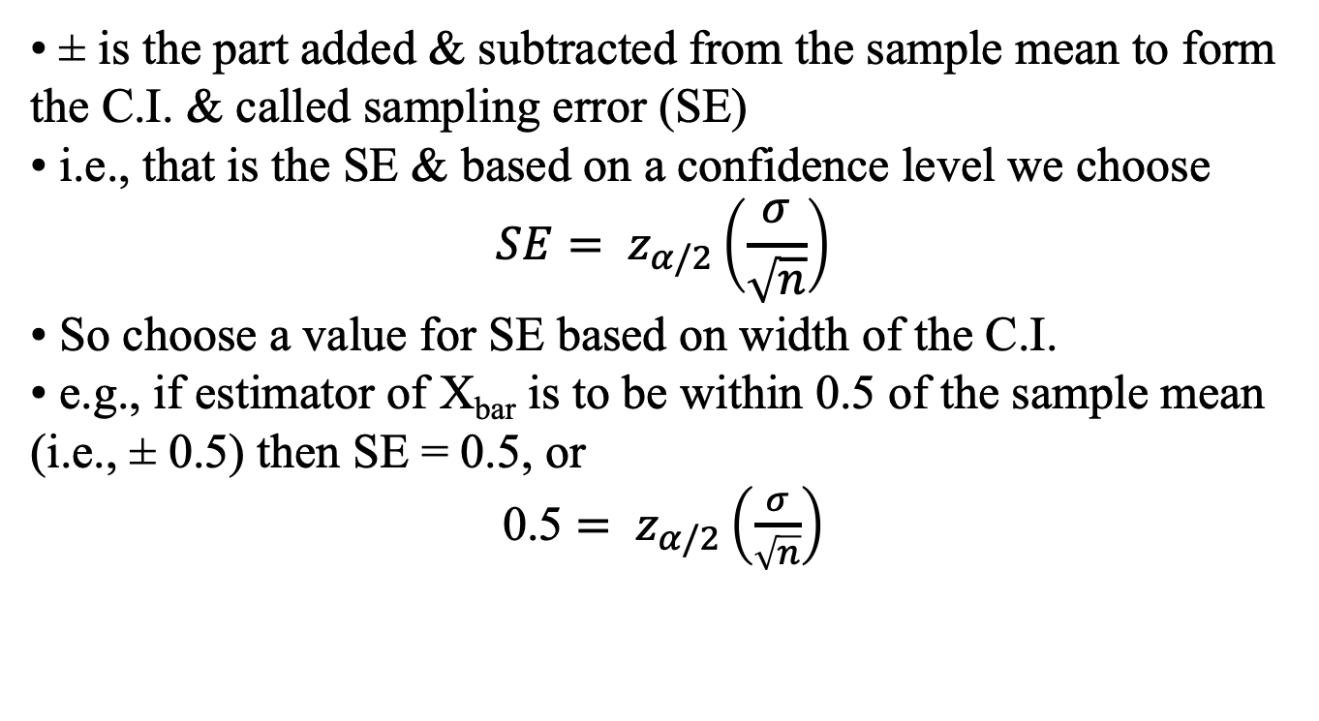
Determining Sample Size - n
• ± is the part added & subtracted from the sample mean to form the C.I. & called sampling error (SE)
• i.e., that is the SE & based on a confidence level we choose
$$SE= z_{α/2}\left(\frac{σ}{\sqrt{n}}\right)$$
• So choose a value for SE based on width of the C.I.
• e.g., if estimator of X_{bar} is to be within 0.5 of the sample mean (i.e., ± 0.5) then SE = 0.5, or
0.5 $= z_{α/2}\left(\frac{σ}{\sqrt{n}}\right)$

Slide 3
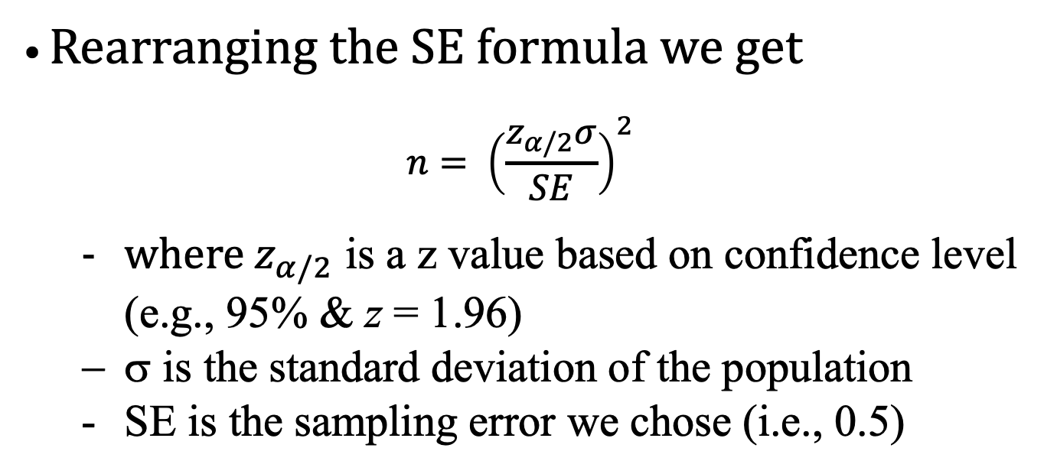
Determining Sample Size - n
• Rearranging the SE formula we get
$$n= {\left(\frac{z_{α/2}σ}{SE}\right)}^{2}$$
  where $z_{α/2}$ is a z value based on confidence level (e.g., 95% & z = 1.96)
  σ is the standard deviation of the population
  SE is the sampling error we chose (i.e., 0.5)

Slide 4
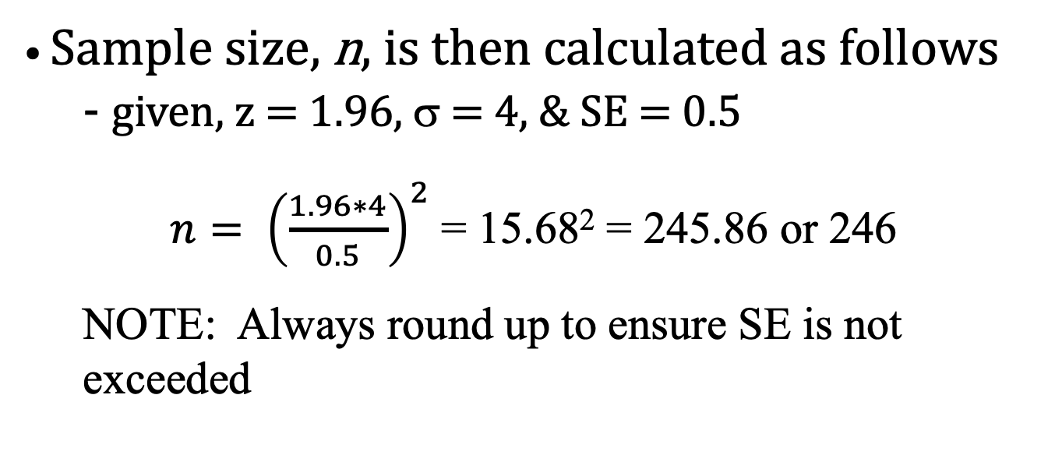
Determining Sample Size - n
• Sample size, n, is then calculated as follows
  - given, z = 1.96, σ = 4, & SE = 0.5
$n= {\left(\frac{1.96∗4}{0.5}\right)}^{2}$= 15.68² = 245.86 or 246
  NOTE: Always round up to ensure SE is not exceeded

Slide 5
Determining Sample Size - n
• Factors affecting sample size:
  Higher confidence level requires larger sample size (i.e., at 95% z = 1.96 but at 99% z = 2.58, so numerator in sample size equation gets bigger)
  Lower SE requires larger sample size (i.e., SE is in equation denominator & lower SE makes sample size bigger)
  Larger σ requires larger sample size (i.e., σ is in the equation numerator & higher σ makes sample size bigger)

Slide 6
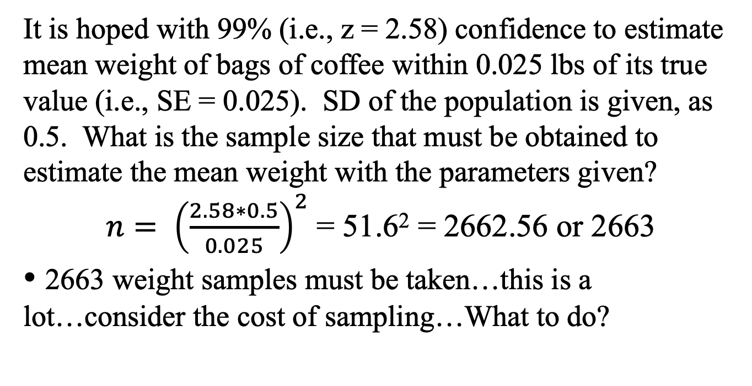
Sample Size Determination – Example I
It is hoped with 99% (i.e., z = 2.58) confidence to estimate mean weight of bags of coffee within 0.025 lbs of its true value (i.e., SE = 0.025). SD of the population is given, as 0.5. What is the sample size that must be obtained to estimate the mean weight with the parameters given?
$n= {\left(\frac{2.58∗0.5}{0.025}\right)}^{2}$= 51.6² = 2662.56 or 2663
• 2663 weight samples must be taken…this is a lot…consider the cost of sampling…What to do?

Slide 7
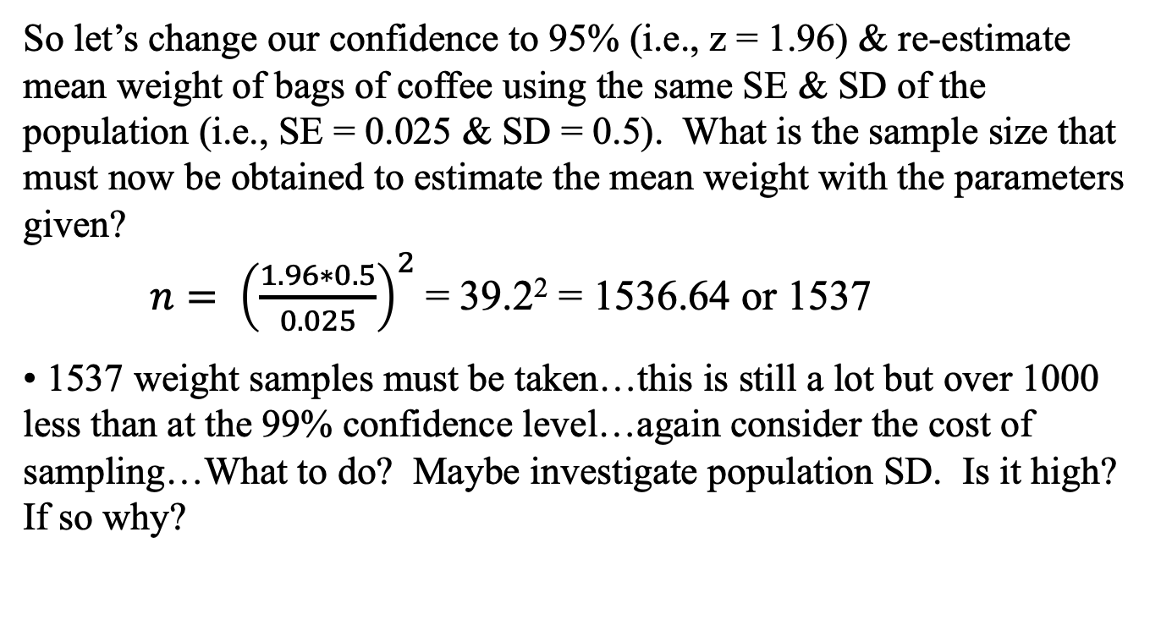
Sample Size Determination – Example II
So let’s change our confidence to 95% (i.e., z = 1.96) & re-estimate mean weight of bags of coffee using the same SE & SD of the population (i.e., SE = 0.025 & SD = 0.5). What is the sample size that must now be obtained to estimate the mean weight with the parameters given?
$n= {\left(\frac{1.96∗0.5}{0.025}\right)}^{2}$= 39.2² = 1536.64 or 1537
• 1537 weight samples must be taken…this is still a lot but over 1000 less than at the 99% confidence level…again consider the cost of sampling…What to do? Maybe investigate population SD. Is it high? If so why?

Slide 8
Final Note
• Sometimes the formula may yield a small sample size, i.e., n <30
• Unfortunately, the solution is invalid. Why?
• Small samples (n<30) differs from large samples
• Therefore, if the formula yields n<30, simply chose a sample size >30

