Slide 1
Inferential Statistics – Small Sample Sizes
Statistical inference is an estimate or prediction about a population based on sample information
As before, uses sample data to
  Make estimates
  Make decisions
  Make predictions
However, now sample size is small (i.e., n<30)
What to do now?

Slide 2
Estimation Process
Population
Random Sample is small
Mean
Xbar = 50
but n < 30
Mean, μ, is unknown
☺
☺
☺
☺
☺
☺
☺
Sample
☺
I am 95% confident that μ is between 42 & 58 but sample is small. What to do now?
☺
☺
☺
Notes:
9

Slide 3
Confidence Interval Estimates
O
n
e
P
o
p
u
l
a
t
i
o
n
M
e
a
n
P
r
o
p
o
r
t
i
o
n
L
a
r
g
e
S
m
a
l
l
S
a
m
p
l
e
S
a
m
p
l
e
Z
t
Z
D
i
s
t
r
i
b
u
t
i
o
n
D
i
s
t
r
i
b
u
t
i
o
n
D
i
s
t
r
i
b
u
t
i
o
n

Slide 4
Small Sample Confidence Intervals
• n=30 is the magic number
• Why is this the magic number?
• Compare Z and t-tables?
• What is the difference/similarity?

Slide 5
Z versus t Distributions
P(X)
Z
t
X
What happens when n ----> 30? t looks like Z

Slide 6
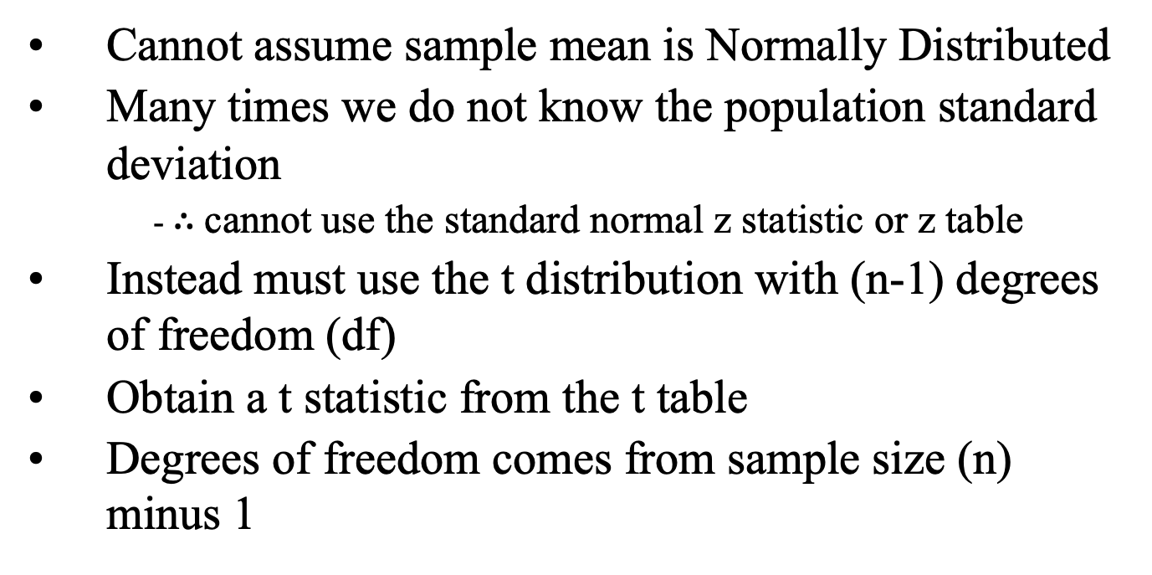
Confidence Interval for Small Sample Sizes
Cannot assume sample mean is Normally Distributed
Many times we do not know the population standard deviation
  - $∴$cannot use the standard normal z statistic or z table
Instead must use the t distribution with (n-1) degrees of freedom (df)
Obtain a t statistic from the t table
Degrees of freedom comes from sample size (n) minus 1
Notes:
27

Slide 7
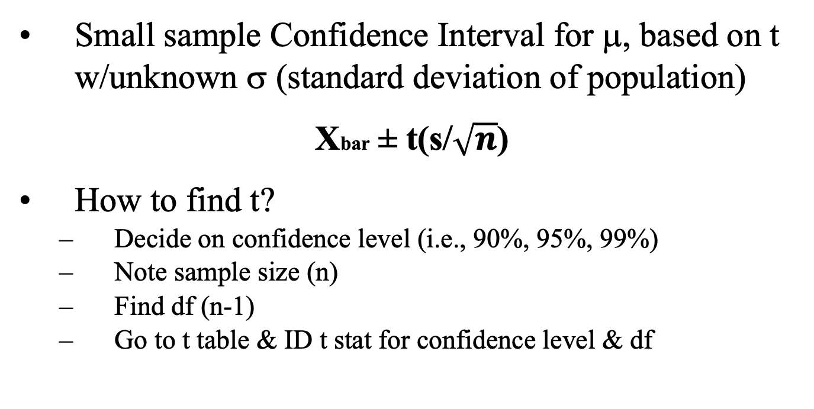
Confidence Interval for Small Sample Size
Small sample Confidence Interval for μ, based on t w/unknown σ (standard deviation of population)
Xbar ± t(s/$\sqrt{n}$)
How to find t?
  Decide on confidence level (i.e., 90%, 95%, 99%)
  Note sample size (n)
  Find df (n-1)
  Go to t table & ID t stat for confidence level & df
Notes:
27

Slide 8
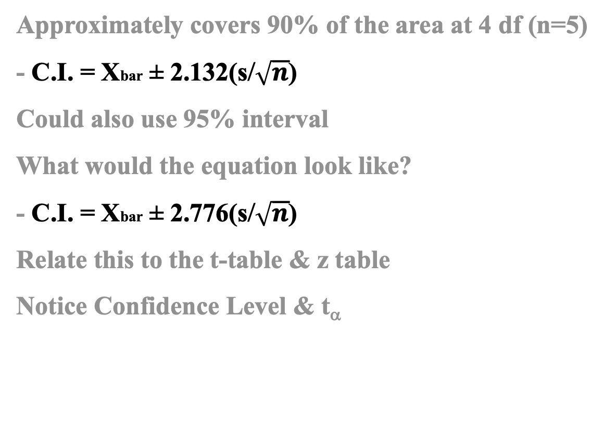
Small Sample Confidence Intervals
Approximately covers 90% of the area at 4 df (n=5)
- C.I. = Xbar ± 2.132(s/$\sqrt{n}$)
Could also use 95% interval
What would the equation look like?
- C.I. = Xbar ± 2.776(s/$\sqrt{n}$)
Relate this to the t-table & z table
Notice Confidence Level & t_{α}
Partial t Table
 | 90% confidence | 95% confidence | 99% confidence
Degrees of Freedom | t0.05 | t0.025 | t0.005
1 | 6.314 | 12.706 | 63.657
2 | 2.920 | 4.303 | 9.925
3 | 2.353 | 3.182 | 5.841
4 | 2.132 | 2.776 | 4.604
5 | 2.015 | 2.571 | 4.032
6 | 1.943 | 2.447 | 3.707
7 | 1.895 | 2.365 | 3.499
.
.
.
infinity | 1.645 | 1.960 | 2.576

Slide 9
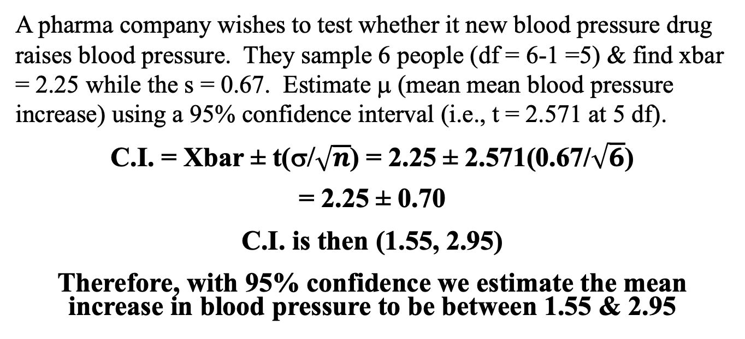
Small Sample Confidence Interval Example
A pharma company wishes to test whether it new blood pressure drug raises blood pressure. They sample 6 people (df = 6-1 =5) & find xbar = 2.25 while the s = 0.67. Estimate μ (mean mean blood pressure increase) using a 95% confidence interval (i.e., t = 2.571 at 5 df).
C.I. = Xbar ± t(σ/$\sqrt{n}$) = 2.25 ± 2.571(0.67/$\sqrt{6}$)
= 2.25 ± 0.70
C.I. is then (1.55, 2.95)
Therefore, with 95% confidence we estimate the mean increase in blood pressure to be between 1.55 & 2.95

Slide 10
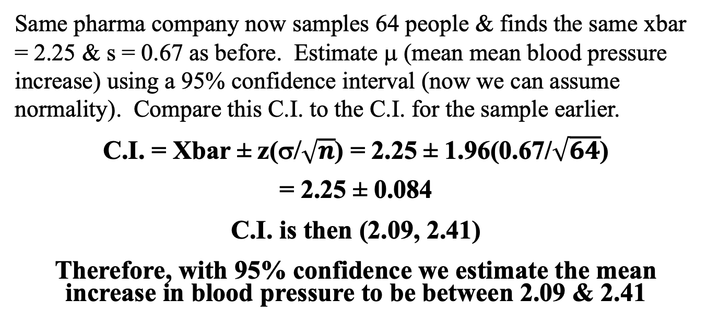
Small Sample Confidence Interval Example II
Same pharma company now samples 64 people & finds the same xbar = 2.25 & s = 0.67 as before. Estimate μ (mean mean blood pressure increase) using a 95% confidence interval (now we can assume normality). Compare this C.I. to the C.I. for the sample earlier.
C.I. = Xbar ± z(σ/$\sqrt{n}$) = 2.25 ± 1.96(0.67/$\sqrt{64}$)
= 2.25 ± 0.084
C.I. is then (2.09, 2.41)
Therefore, with 95% confidence we estimate the mean increase in blood pressure to be between 2.09 & 2.41

