Slide 1
Inferential Statistics
Statistical inference is an estimate or prediction about a population based on sample information
Uses sample data to
  Make estimates
  Make decisions
  Make predictions

Slide 2
Five Elements of Inferential Statistics
Population of Interest (consumers who drink cola)
One or more variable to be investigated (cola preference)
Sample of the population (1000 cola drinkers)
Inference statement about the population based on sample info (% that prefer Coke)
Measure of reliability (degree of uncertainty with the inference – e.g., +/- 5%)
Notes:
5

Slide 3
Estimation Process
Population
Random Sample
Mean
Xbar = 50
Mean, μ, is unknown
☺
☺
☺
☺
☺
☺
☺
Sample
☺
I am 95% confident that μ is between 42 & 58.
☺
☺
☺
Notes:
9

Slide 4
Unknown Population Parameters Are Estimated
Estimate population
with sample
parameter...
statistic
Mean
μ
xbar
Proportion
p
^
p
Variance
2
2
σ
se
Differences
μ
- μ
xbar
-
xbar
1
2
1
2

Slide 5
Estimation Methods
Estimation
Point
Interval
Estimation
Estimation
Notes:
14

Slide 6
Point Estimation
1. Provides single value
  Based on observations from 1 sample
2. Gives no information about how close value is to the unknown population parameter
3. Example: Sample mean xbar = 3 is point estimate of unknown population mean

Slide 7
Estimation Methods
Estimation
Point
Interval
Estimation
Estimation
Notes:
14

Slide 8
Confidence Interval Estimates
O
n
e
P
o
p
u
l
a
t
i
o
n
M
e
a
n
P
r
o
p
o
r
t
i
o
n
L
a
r
g
e
S
m
a
l
l
S
a
m
p
l
e
S
a
m
p
l
e
Z
t
Z
D
i
s
t
r
i
b
u
t
i
o
n
D
i
s
t
r
i
b
u
t
i
o
n
D
i
s
t
r
i
b
u
t
i
o
n

Slide 9
Interval Estimation
1. Provides range of values
  Based on observations from 1 sample
2. Gives information about closeness to unknown population parameter
  Stated in terms of probability
  Knowing exact closeness requires knowing unknown population parameter
3. Example: unknown population mean lies between 50 & 70 with 95% confidence

Slide 10
Key Elements of Interval Estimation
A probability that the population parameter falls somewhere within the interval.
Confidence interval
Sample statistic
(point estimate)
Confidence limit (lower)
Confidence limit (upper)
Notes:
26

Slide 11
Many Samples Have Same Interval
Xbar = μ ± Zσ_{xbar}
X
μ
μ+1.65σ_{xbar} μ+2.58σ_{xbar}
μ-2.58σ_{xbar} μ-1.65σ_{xbar}
μ-1.96σ_{xbar}
μ+1.96σ_{xbar}
90% Samples
95% Samples
99% Samples
Notes:
33

Slide 12
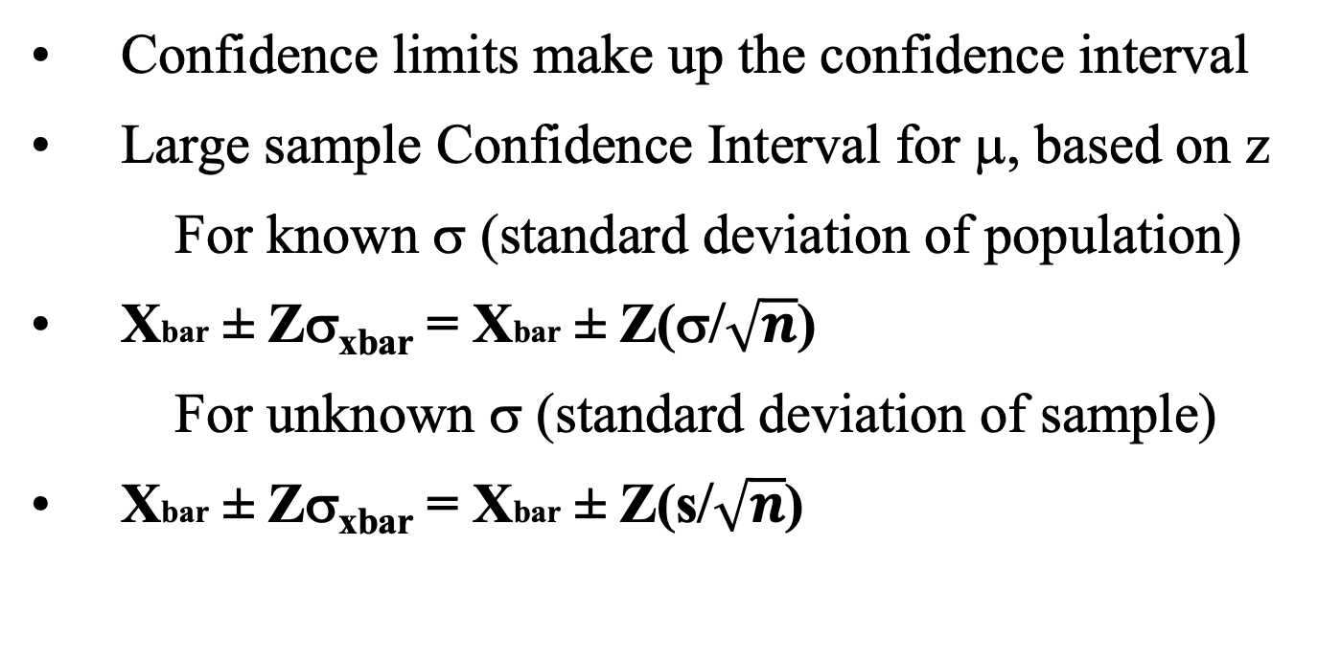
Confidence Interval for Population Mean
Confidence limits make up the confidence interval
Large sample Confidence Interval for μ, based on z
For known σ (standard deviation of population)
Xbar ± Zσ_{xbar} = Xbar ± Z(σ/$\sqrt{n}$)
For unknown σ (standard deviation of sample)
Xbar ± Zσ_{xbar} = Xbar ± Z(s/$\sqrt{n}$)
Notes:
27

Slide 13
Confidence Level
1. Probability that the unknown population parameter falls within interval
2. Denoted (1 - α) %
α is probability that parameter is not within interval (e.g., 10%, 5%, or 1%)
3. Typical values for confidence level are 90%, 95%, 99%

Slide 14
Factors Affecting Interval Width
1. Data dispersion
  Measured by σ
2. Sample size
  σ_{Xbar} = σ / √n (known std. dev.)
  σ_{Xbar} = s / √n (unknown std. dev.)
3. Level of confidence (1 - α)
  Affects Z
Intervals extend from
Xbar - Zσ_{Xbar} to
Xbar + Zσ_{Xbar}
Notes:
Have students explain why each of these occurs.
Level of confidence can be seen in the sampling distribution.

Slide 15
Large Sample Confidence Intervals
Table 1. Commonly Used Values of z
Confidence Level 100(1- α)% | α | α/2 | z α/2
90% | 0.10 | 0.05 | 1.645
95% | 0.05 | 0.025 | 1.960
98% | 0.02 | 0.01 | 2.326
99% | 0.01 | 0.005 | 2.575

Slide 16
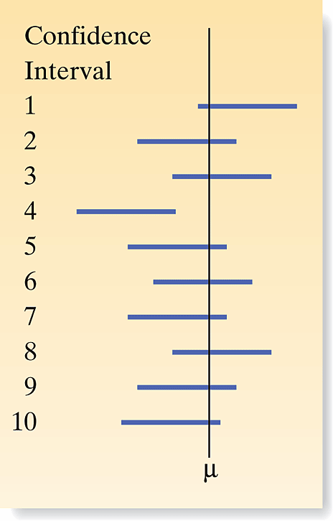
Large Sample Confidence Intervals
• Obtain a point estimate of the mean, Xbar
• How accurate is Xbar?
  - depends of confidence level, α (e.g., 90%, 95%)
• Should we care?
• Why should we care?
• What do we do with standard error?
• What does the equation look like?
Figure 1. Confidence Intervals for mean: 10 samples

Slide 17
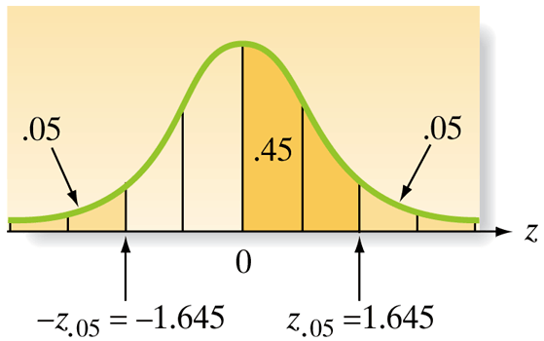
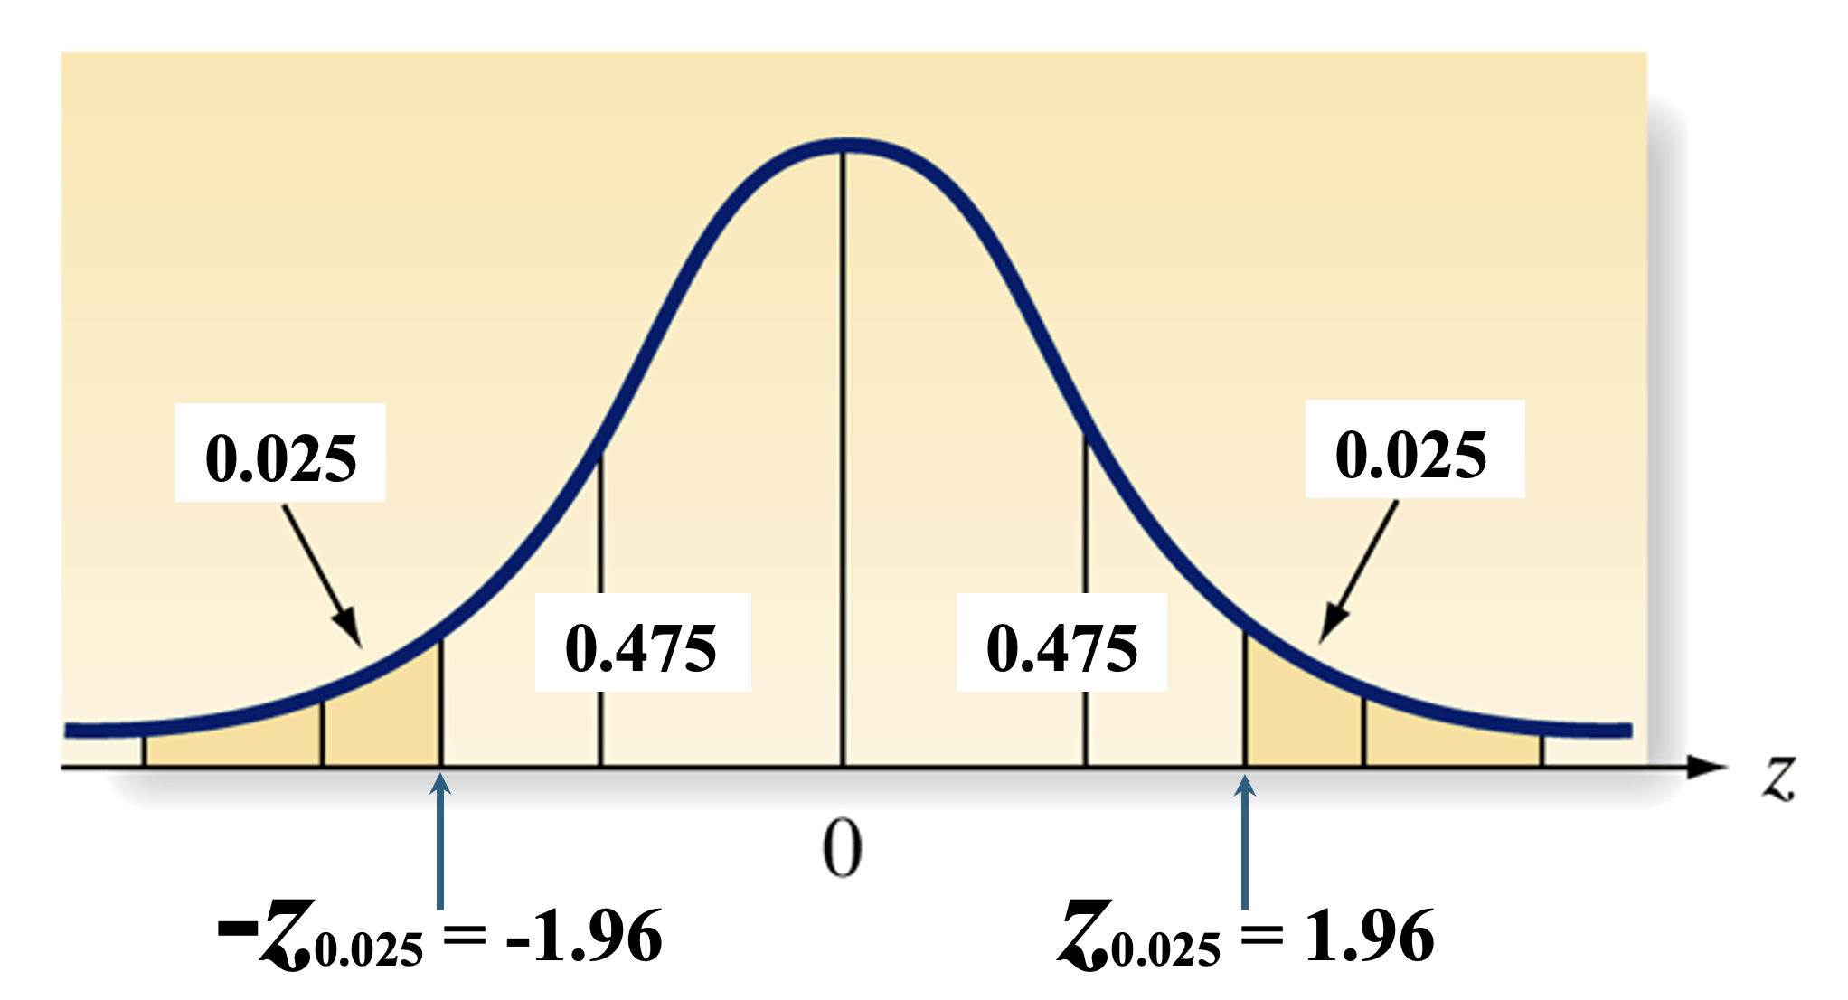
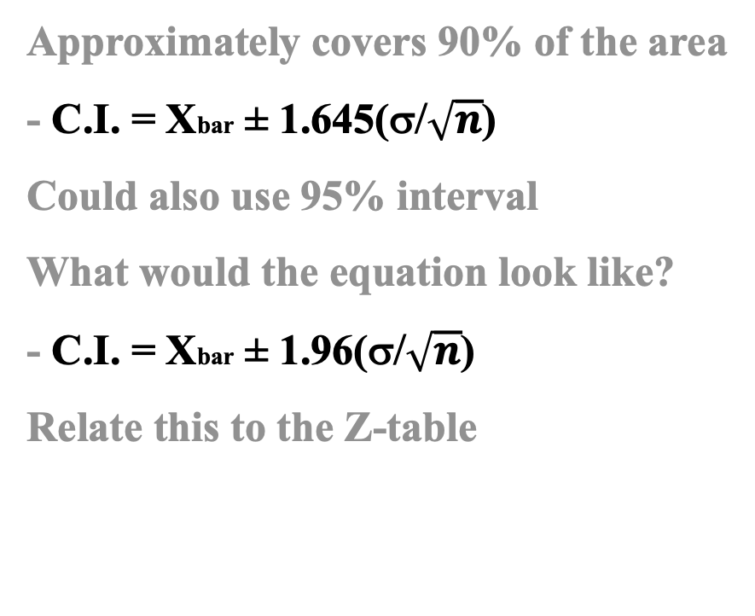
Large Sample Confidence Intervals
Approximately covers 90% of the area
- C.I. = Xbar ± 1.645(σ/$\sqrt{n}$)
Could also use 95% interval
What would the equation look like?
- C.I. = Xbar ± 1.96(σ/$\sqrt{n}$)
Relate this to the Z-table

Slide 18
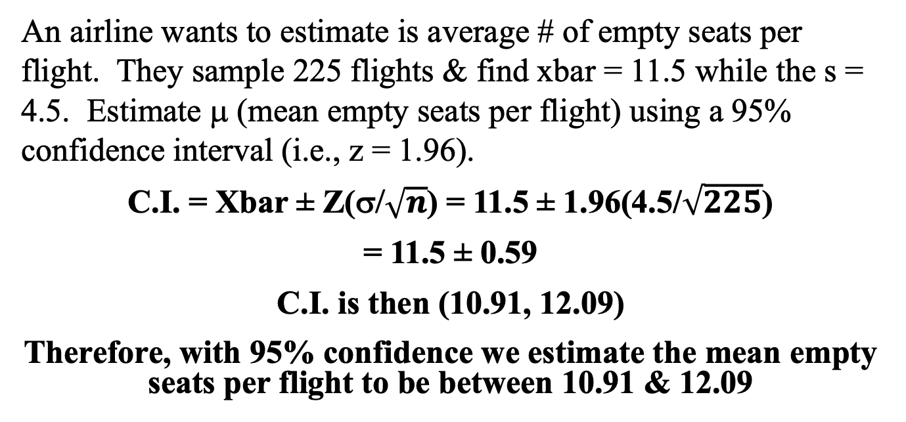
Large Sample Confidence Interval Example
An airline wants to estimate is average # of empty seats per flight. They sample 225 flights & find xbar = 11.5 while the s = 4.5. Estimate μ (mean empty seats per flight) using a 95% confidence interval (i.e., z = 1.96).
C.I. = Xbar ± Z(σ/$\sqrt{n}$) = 11.5 ± 1.96(4.5/$\sqrt{225}$)
= 11.5 ± 0.59
C.I. is then (10.91, 12.09)
Therefore, with 95% confidence we estimate the mean empty seats per flight to be between 10.91 & 12.09

Slide 19
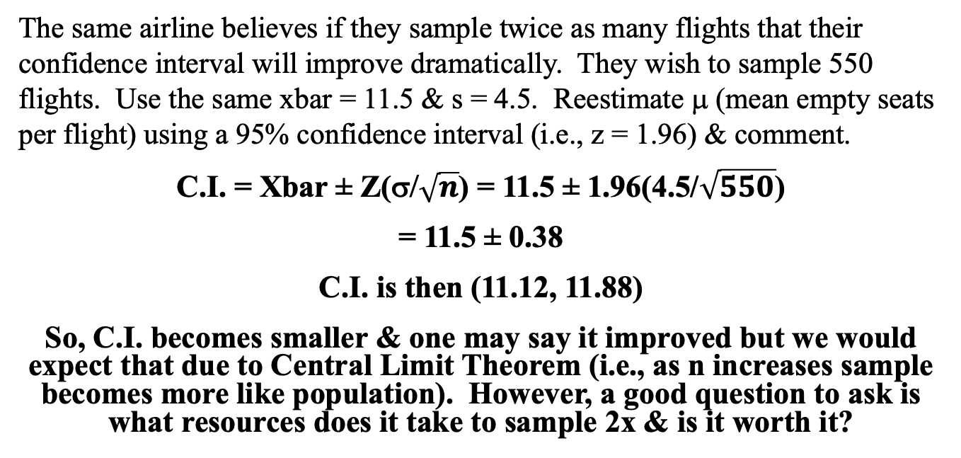
Large Sample Confidence Interval Example II
The same airline believes if they sample twice as many flights that their confidence interval will improve dramatically. They wish to sample 550 flights. Use the same xbar = 11.5 & s = 4.5. Reestimate μ (mean empty seats per flight) using a 95% confidence interval (i.e., z = 1.96) & comment.
C.I. = Xbar ± Z(σ/$\sqrt{n}$) = 11.5 ± 1.96(4.5/$\sqrt{550}$)
= 11.5 ± 0.38
C.I. is then (11.12, 11.88)
So, C.I. becomes smaller & one may say it improved but we would expect that due to Central Limit Theorem (i.e., as n increases sample becomes more like population). However, a good question to ask is what resources does it take to sample 2x & is it worth it?

