Slide 1
Random Variables
A random variable is a numerical value determined by the outcome of a random event
Discrete Random Variable: Can take on a countable number of distinct values
  Number of heads in 10 coin tosses
Continuous Random Variable: Can take any value within a given range
  Height of students in a class

Slide 2
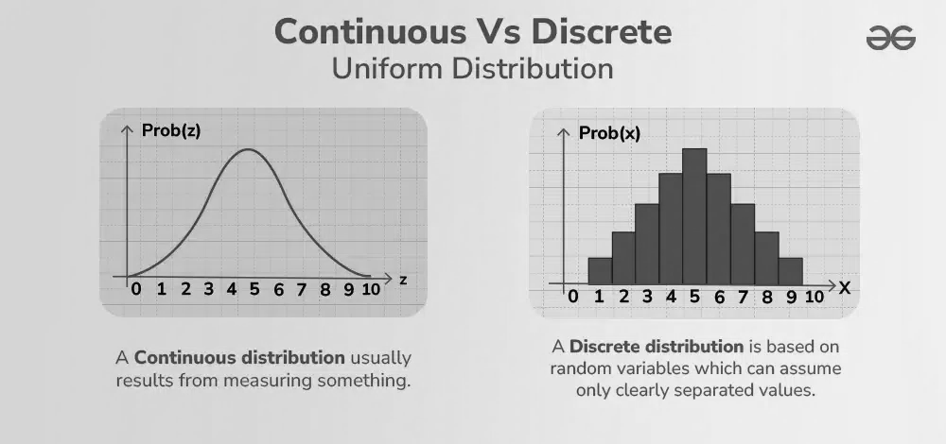
Random Variables

Slide 3
Random Variables as Estimators
1. Random variables used to estimate a population parameter
  Sample mean, sample proportion, sample median
2. Example: Sample mean xbar is an estimator of population mean μ
  If xbar = 3 then 3 is the estimate of μ
3. Theoretical basis is sampling distribution

Slide 4
Sampling Distribution
1. Theoretical probability distribution
2. Random variable is sample statistic
  Sample mean, sample proportion etc.
3. Results from drawing all possible samples of a fixed size
4. List of all possible [xbar, P(xbar) ] pairs
  Sampling distribution of mean

Slide 5
Properties of Sampling Distribution of Mean
1. Unbiasedness
  Mean of sampling distribution equals population mean
2. Efficiency
  Sample mean comes closer to population mean than any other unbiased estimator
3. Consistency
  As sample size increases, variation of sample mean from population mean decreases
Notes:
An estimator is a random variable used to estimate a population parameter (characteristic).
Unbiasedness
An estimator is unbiased if the mean of its sampling distribution is equal to the population parameter.
Efficiency
The efficiency of an unbiased estimator is measured by the variance of its sampling distribution.
If two estimators, with the same sample size, are both unbiased, then the one with the smaller variance has greater relative efficiency.
Consistency
An estimator is a consistent estimator of a population parameter if the larger the sample size, the more likely it is that the estimate will come close to the parameter.

Slide 6
Unbiasedness
P
(
Xbar
)
Unbiased
Biased
A
C
Xbar
μ = mean

Slide 7
Efficiency
P
(
Xbar
)
Sampling distribution of mean
B
Sampling distribution of median
A
μ
Xbar

Slide 8
Consistency
P
(
Larger sample size
Xbar
)
B
Smaller sample size
A
Xbar

Slide 9
Central Limit Theorem
As sample size becomes large, the sampling distribution of the sample mean will be approximately normal, regardless of the population's distribution
Justifies the use of normal distribution
Sample Size Rule: A common rule is n >= 30 for the CLT to apply
Symmetric Populations: Smaller samples may suffice if the population is symmetric
Highly Skewed Populations: Larger samples are needed for the sampling distribution to be normal

Slide 10
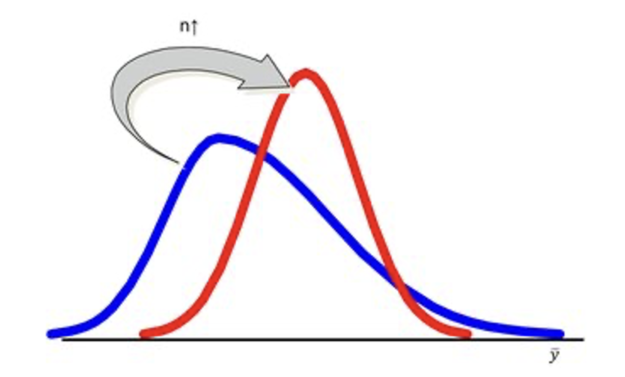
Central Limit Theorem
As sample size gets
large
enough
(n > 30)...
sampling distribution becomes almost normal

